Slide 1
University of Basrah Al-zahraa medical college
Ministry of higher Education and Scientific Researches
The module: URINARY SYSTEM MODULE
Session 5 Lecture 1
MODULE STAFF:
Prof.Mahmood Shakir Dr.Adnan Othafa Ass.Prof.Firas Shakir
Dr. Safaa Taha Dr.Khaldoon Sadek
Plasma osmolarity
For more detailed instruction, any question, cases need help please post to the group of session.
Clinically Orientated Anatomy Moore KL ,DalleyAF&Agur AMR
Publisher:Lippincott Williams and Wilkins:Seventh Edition: ISBN:9781451184471

Slide 2
1-osmosis principls 2-control of osmosis
University of Basrah Al-zahraa medical college
Ministry of higher Education and Scientific Researches
Learning out come
For more detailed instruction, any question, cases need help please post to the group of session.

Slide 3
What is osmsis the process of movement of water across a semipermeable membrane in response to concentration gradiant
University of Basrah Al-zahraa medical college
Ministry of higher Education and Scientific Researches
LO1
For more detailed instruction, any question, cases need help please post to the group of session.

Slide 4
University of Basrah Al-zahraa medical college
LO2what control
What control osmosis
The diffusion of water by osmosis is due to the presence of different concentrations of solutes on either side of a membrane that will drive water to move from one side to the other in order to get to equilibrium of the concentration of solute on both sides.
For more detailed instruction, any question, cases need help please post to the group of session.

Slide 5
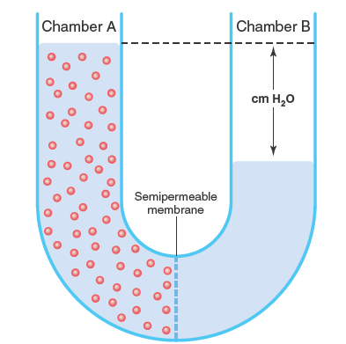
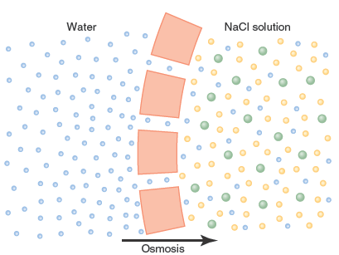
University of Basrah Al-zahraa medical college
Ministry of higher Education and Scientific Researches
LO2
For more detailed instruction, any question, cases need help please post to the group of session.

Slide 6
What is the osmotic pressure the pressure that the concentration gradiant difference exert on water to undergo osmosis through membrane
University of Basrah Al-zahraa medical college
Ministry of higher Education and Scientific Researches
LO1
For more detailed instruction, any question, cases need help please post to the group of session.

Slide 7
Osmosis deal with water movement in the body compartments ,and since Na is the main ion controlling water volume there for the concentration of NaCl is the main control of plasma osmolarity osmolarity= mosmol\liter osmolality = mosmol\kg at 37 temp osmolality=osmolarity normal value is between 280-300 mosmol\l if cell with 280 mosmol\l exposed to pure water osmotic pressure =5400 mmHg
University of Basrah Al-zahraa medical college
Ministry of higher Education and Scientific Researches
LO1
For more detailed instruction, any question, cases need help please post to the group of session.

Slide 8
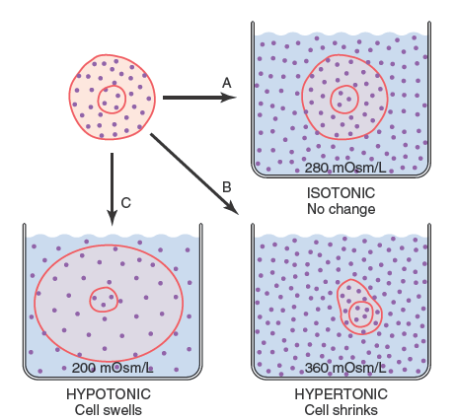
University of Basrah Al-zahraa medical college
Ministry of higher Education and Scientific Researches
LO2
For more detailed instruction, any question, cases need help please post to the group of session.

Slide 9
ECF and ICF osmolarity is equal and maintained in balance osmolarity can change in : 1-solute change (NaCl) 2-water content of the body change e g fasting,vomiting ,diarrhoea,sweating,excessive fluid intake or excessive salt in take osmosis is controled by ; ADH thirst renal concentrating properties
University of Basrah Al-zahraa medical college
Ministry of higher Education and Scientific Researches
LO2
For more detailed instruction, any question, cases need help please post to the group of session.

Slide 10
How dose the body sense the chnge in osmolarity? The body has osmoreceptors mainly in the third ventricle in the brain if there is dehydration plasma osmolarity increse-----brain oemoreceptors stimulated leading to 1-stimulate the hypothalamus to produce ADH---decrease H2O loss 2-stimulate the insula and the anterior cingulate gyrus of cerebral cortex leading to feeling of thirst
University of Basrah Al-zahraa medical college
Ministry of higher Education and Scientific Researches
LO2
For more detailed instruction, any question, cases need help please post to the group of session.

Slide 11
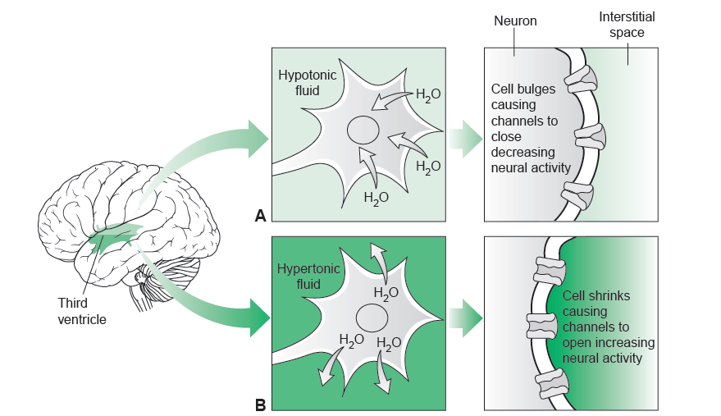
University of Basrah Al-zahraa medical college
Ministry of higher Education and Scientific Researches
LO2
For more detailed instruction, any question, cases need help please post to the group of session.

Slide 12
Osmoreceprors sense 1-2 % change in plasma osmolarity it stimulate ADH secretion by a change of 275-290 average 280 it stimulate thirst by a change of 285-305 average 290 blood pressure change by 20-30% of volume of plasma can trigger ADH
University of Basrah Al-zahraa medical college
Ministry of higher Education and Scientific Researches
LO2
For more detailed instruction, any question, cases need help please post to the group of session.

Slide 13
water handeling by the nephron the ultrafiltraate is isosmotic to plasma in the PCT there is absorptin of NaCl and water but still isosmotic descending loop hyperosmotic 600 absorption of water no Na abs. ascending loop hyposmotic no water abs. but more Na abs.100-50 DCT and collecting tubules hyposmolar more Na abs. water abs under control of ADH
University of Basrah Al-zahraa medical college
Ministry of higher Education and Scientific Researches
LO2
For more detailed instruction, any question, cases need help please post to the group of session.

Slide 14
University of Basrah Al-zahraa medical college
Ministry of higher Education and Scientific Researches
LO2
For more detailed instruction, any question, cases need help please post to the group of session.

Slide 15
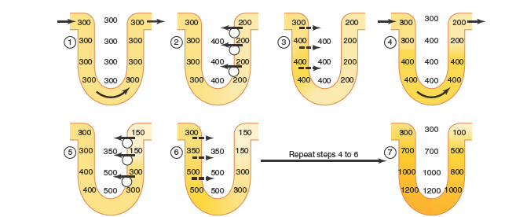
University of Basrah Al-zahraa medical college
Ministry of higher Education and Scientific Researches
LO2
For more detailed instruction, any question, cases need help please post to the group of session.

Slide 16
Urea play role in the concentrating ablity of the kidney by recerculating it from the collecting duct to the loop through the interstitium
University of Basrah Al-zahraa medical college
Ministry of higher Education and Scientific Researches
LO2
For more detailed instruction, any question, cases need help please post to the group of session.

Slide 17
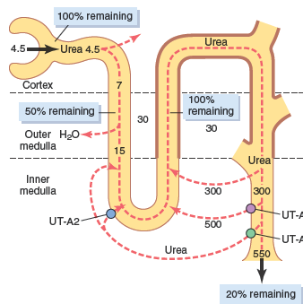
University of Basrah Al-zahraa medical college
Ministry of higher Education and Scientific Researches
LO2
For more detailed instruction, any question, cases need help please post to the group of session.

Slide 18
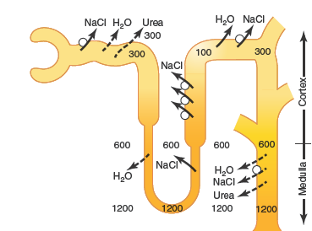
University of Basrah Al-zahraa medical college
Ministry of higher Education and Scientific Researches
For more detailed instruction, any question, cases need help please post to the group of session.

Slide 19
What is the role of ADH in osmotic regulation of plasma
University of Basrah Al-zahraa medical college
Ministry of higher Education and Scientific Researches
For more detailed instruction, any question, cases need help please post to the group of session.

Slide 20
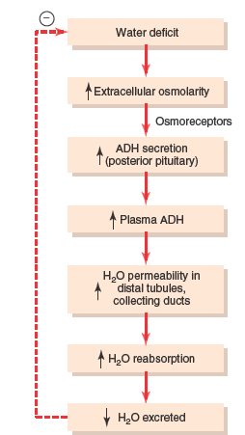
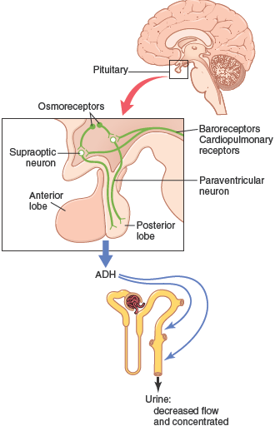
University of Basrah Al-zahraa medical college
Ministry of higher Education and Scientific Researches
For more detailed instruction, any question, cases need help please post to the group of session.

Slide 21
Daily need of Na 10-20 meq\l\day we eat 100-20 meq\l\day increase Na =increase plasma osmolarity it trigger thirst that drive you to drink water+ADH ADH can abnormaly secreted decrease =diabetes insipidus increase=inapproperiate ADH secretion
University of Basrah Al-zahraa medical college
Ministry of higher Education and Scientific Researches
For more detailed instruction, any question, cases need help please post to the group of session.

